Slide 1

Socio-economics determinants of poverty in europe
Tito Rodolfo Maraz Galassi - 278030
Leo Marcello Poli – 280899
Pietro Filippo Schgor - 258727
Nonparametric Statistics 2025-2026

Slide 2
Socio-economics determinants of poverty in europe
Tito Rodolfo Maraz Galassi - 278030
Leo Marcello Poli – 280899
Pietro Filippo Schgor - 258727
Nonparametric Statistics 2025-2026

Slide 3
The dataset at the center of this analysis, sourced from Eurostat, combines two key indicators: the At-risk-of-poverty rate and detailed data on Social Protection Expenditure.
The origin of this data is the EU-SILC (Statistics on Income and Living Conditions) survey, which collects multidimensional microdata on income, poverty, and social exclusion. EU-SILC uses a nationally representative sample of private households, combining survey and administrative data to ensure comparability.
The objective is to analyze the relationship between national social spending strategies and key socio-economic outcomes related to poverty.

Slide 4
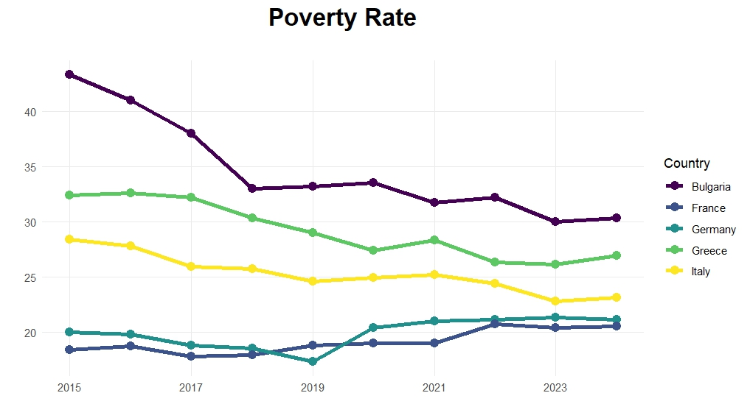
Curves of At-risk-of-poverty rate from 2015 to 2024 of a selection of Countries

